Slide 1
Maven Market:
Driving profitability through SQL insights
By:
AJIGBTOSHO Hammed Olaitan
April 2025

Slide 2
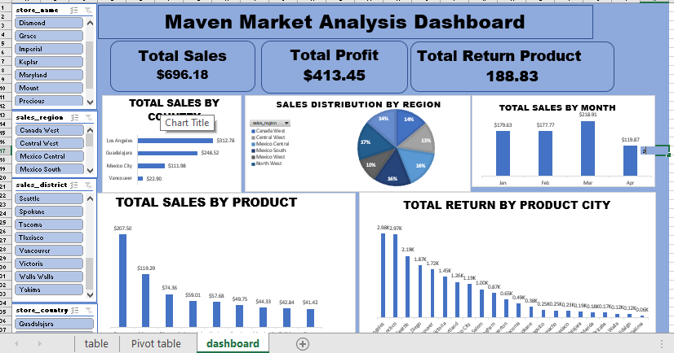
Abstract
This project leverages SQL to analyze sales, returns and operational efficiency for Maven Market, a retail chain. This project explored (101, 21) datasets.
This dashboard provides an in-depth analysis of sales and profit data from various stores, focusing on key metrices such as total sales, profit and return quantities across different regions and products. It helps in identifying sales trends, regional performance and profitability insights.

Slide 3
introduction
Background:
Marven Market faces challenges in tracking sales, reducing returns and improving store efficiency.
Problem Statement:
Lack of visibility into profit margins, regional disparities and store performance
Objectives:
Identify top-performing products and regions
Diagnose return patterns
Provide actionable operational insights

Slide 4
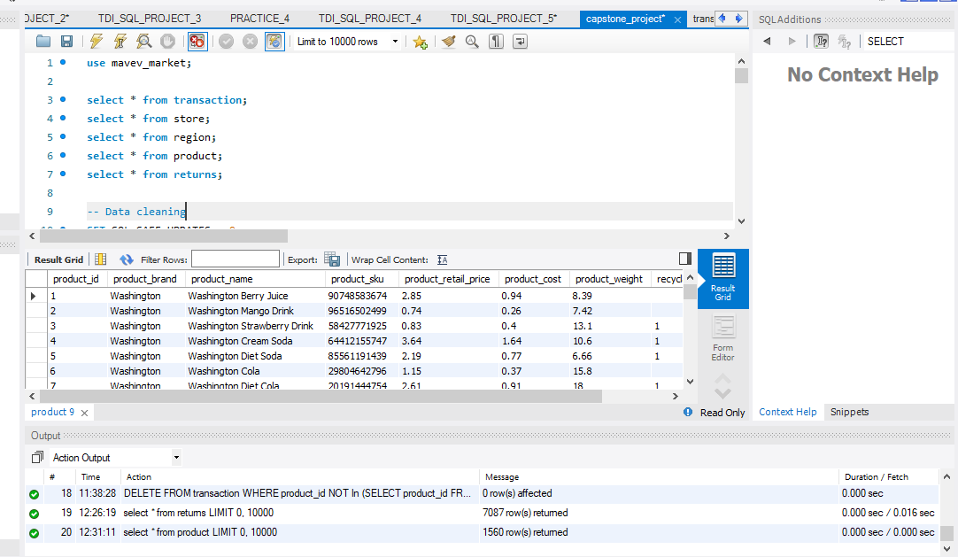
Data description

Slide 5
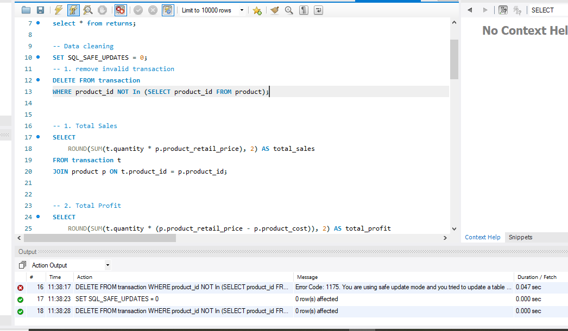
methodology
Data Cleaning:
Remove invalid transaction (DELETE with foreign key checks)
2. Analysis
Used SQL joins, CTEs and CASE statement
3. Visualization
Excel pivot tables and interactive dashboard

Slide 6
Analysis and results
Key Insights:
Descent stores achieved the highest total sales $207.50 among all stores, while Grace store achieved the lowest stores $41.42, highlighting a disparity in performance.
Sales reached peak value of $218.91 in march indicating high demand of product.
Los Angeles Has the highest quantity of product returned 2.98k products, indicating low sales in the city.
Regionally, the North West outperformed other areas with the highest total sales, whereas both Mexico West and Mexico lagged behind, suggesting areas with potential for growth

Slide 7
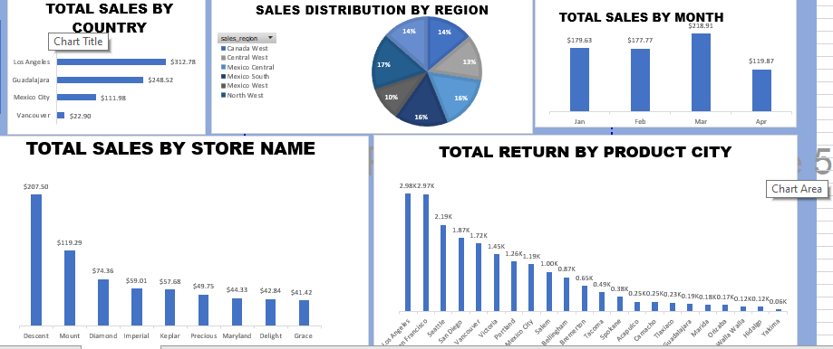
Key insights (contd)

Slide 8

Key Insights (Contd)
Excel interactive Dashboard:
Interactive visualizations (bar charts, pie chart, column chart)
KPIs (total sales, total profit, Highest unit sold)
Filters for dynamic exploration analysis

Slide 9
RECOMMENDATION
Focus on Descent store and North West regions to generate higher sales
Target March for high revenue
Launch recyclable product campaigns to prevent retuned product
Create public awareness at region where there’s low sales.

Slide 10
discussion
Limitations:
No customer demographic data for segmentation
Future work:
Integrate inventory data for stock turnover analysis

Slide 11
CONCLUSION
Summary:
SQL analysis revealed actionable insights into product performance and store efficiency
Impact:
Potential annual savings: $600 through reduced returns and optimized operations

Slide 12
Thanks for listening

